Slide 1
Object Oriented Software Engineering (OOSE)
22CS017
Risk Mitigation, Monitoring and Management (RMMM) plan

Slide 2
Index
Risk Mitigation
Risk Monitoring
Risk Management and Planning
RMMM plan
RMMM plan- RIS example
Practice Questions

Slide 3
Risk Mitigation
All of the risk analysis activities presented to this point have a single goal—to assist the project team in developing a strategy for dealing with risk.
An effective strategy must consider three issues: risk mitigation, risk monitoring, and risk management and contingency planning.
If a software team adopts a proactive approach to risk, avoidance is always the best strategy. This is achieved by developing a plan for risk mitigation.
To mitigate this risk, you would develop a strategy for reducing turnover. Among the possible steps to be taken are:
Meet with current staff to determine causes for turnover (e.g., poor working conditions, low pay, competitive job market).
Mitigate those causes that are under your control before the project starts.

Slide 4
Risk Mitigation
Once the project commences, assume turnover will occur and develop techniques to ensure continuity when people leave.
Organize project teams so that information about each development activity is widely dispersed.
Define work product standards and establish mechanisms to be sure that all models and documents are developed in a timely manner.
Conduct peer reviews of all work (so that more than one person is “up to speed”).
Assign a backup staff member for every critical technologist.

Slide 5
Risk Monitoring
As the project proceeds, risk-monitoring activities commence.
The project manager monitors factors that may provide an indication of whether the risk is becoming more or less likely.
In the case of high staff turnover, the general attitude of team members based on project pressures, the degree to which the team has jelled, interpersonal relationships among team members, potential problems with compensation and benefits, and the availability of jobs within the company and outside it are all monitored.
In addition to monitoring these factors, a project manager should monitor the effectiveness of risk mitigation steps.

Slide 6
Risk Management and Planning
Risk management and contingency planning assumes that mitigation efforts have failed and that the risk has become a reality.
Continuing the example, the project is well under way and a number of people announce that they will be leaving. If the mitigation strategy has been followed, backup is available, information is documented, and knowledge has been dispersed across the team.
In addition, you can temporarily refocus resources (and readjust the project schedule) to those functions that are fully staffed, enabling newcomers who must be added to the team to “get up to speed.”
Those individuals who are leaving are asked to stop all work and spend their last weeks in “knowledge transfer mode.”
This might include video-based knowledge capture, the development of “commentary documents or Wikis,” and/or meeting with other team members who will remain on the project.

Slide 7
RMMM Plan
The risk mitigation, monitoring, and management (RMMM) plan may be a part of the software development plan or may be a separate document
Once RMMM has been documented and the project has begun, the risk mitigation, and monitoring steps begin
Risk mitigation is a problem avoidance activity
Risk monitoring is a project tracking activity
Risk monitoring has three objectives
To assess whether predicted risks do, in fact, occur
To ensure that risk aversion steps defined for the risk are being properly applied
To collect information that can be used for future risk analysis

Slide 8
RMMM Plan
The findings from risk monitoring may allow the project manager to ascertain what risks caused which problems throughout the project
Some software teams do not develop a formal RMMM document. Rather, each risk is documented individually using a risk information sheet (RIS).
In most cases, the RIS is maintained using a database system so that creation and information entry, priority ordering, searches, and other analysis may be accomplished easily.
Once RMMM has been documented and the project has begun, risk mitigation and monitoring steps commence.

Slide 9
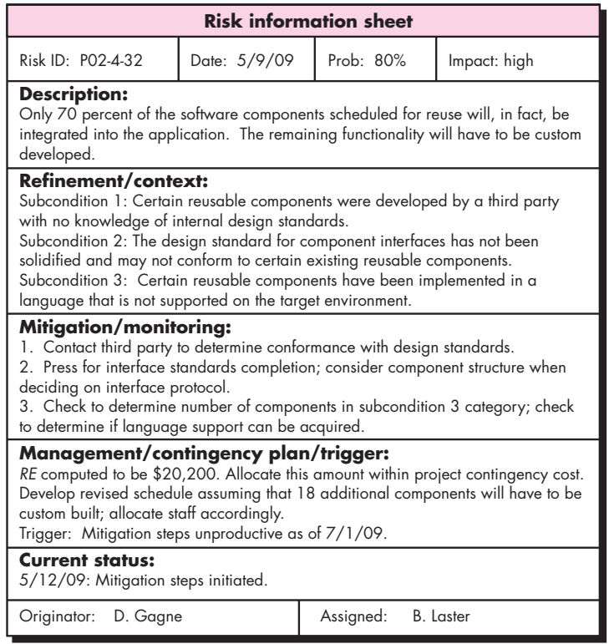
RMMM Plan – RIS Example

Slide 10
Practice Questions
What is the primary purpose of a Risk Mitigation, Monitoring, and Management (RMMM) plan? a) To eliminate all project risks b) To identify, assess, and address potential risks in a project c) To guarantee project success d) To assign blame for project failures
Answer: b) To identify, assess, and address potential risks in a project
Which of the following is NOT a key component of an RMMM plan? a) Risk Identification b) Risk Elimination c) Risk Monitoring d) Risk Mitigation
Answer: b) Risk Elimination
Risk mitigation involves which of the following actions? a) Avoiding all risks b) Developing strategies to reduce the impact or likelihood of risks c) Ignoring minor risks to focus on major ones d) Reporting risks without taking action
Answer: b) Developing strategies to reduce the impact or likelihood of risks

Slide 11
Practice Questions
What is the role of risk monitoring in an RMMM plan? a) To track identified risks and evaluate their status over time b) To remove all project uncertainties c) To assign responsibility for project delays d) To increase project costs
Answer: a) To track identified risks and evaluate their status over time
Which of the following is a key strategy in risk mitigation? a) Avoidance b) Transfer c) Acceptance d) All of the above
Answer: d) All of the above

